Slide 1



Telerik School Academy
Who, What, Why?
Svetlin Nakov
Manager Technical Training
www.nakov.com
Telerik Software Academy
academy.telerik.com
Notes:
<number>

Slide 2


Table of Contents
Telerik School Academy Program
The Trainers Team
Training Schedule
Requirements for the School Students
Exams and Certificates
About Telerik
Telerik Academy
"Software Academy" Program
"Software Academy" for High School Students
<number>

Slide 3

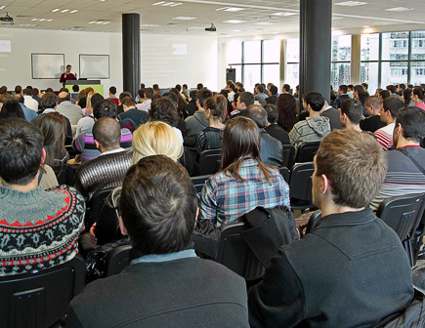

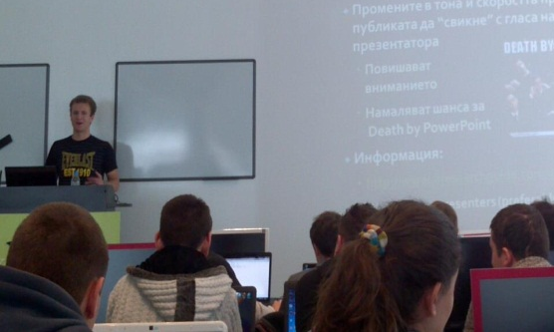
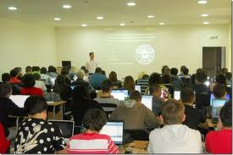
Telerik School Academy
How It Works?

Slide 4
Telerik School Academy for Software Engineers: Objectives
Train school students in software engineering and software technologies, free of charge
Cutting-edge technologies: HTML5, databases, web development, mobile apps, .NET, XAML
Preparation for the National IT Olympiad
Categories: software development, Web development, Web sites, multimedia apps
Preparation for the official IT test
3 full days each month
<number>

Slide 5
We Train Concepts!
We train concepts, not just technologies
Experienced developers know that language and platform does not matter
You are either good developer or lamer
We train OOP, databases, team work, software engineering, Web applications, mobile apps, …
C#, .NET, JavaScript, HTML, are good to illustrate these concepts in practice
Once you become a software engineer, you can easily switch to another platform
<number>

Slide 6
We’re Watching Your Work
Want your School Academy results tracked?
Register in the School Academy courses at telerikacademy.com
Attend the School Academy meetings
Submit the School Academy homework
Defend a practical project + pass an IT test
Collect achievements for your future CV!
Best students will get certificates
Homework, attendance & exams are required
<number>

Slide 7
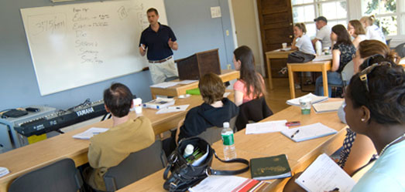
The Trainers Team

Slide 8
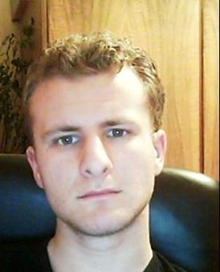
Trainers Team (2)
George Georgiev
Technical Trainer @ Telerik Corp.
Informatics and IT competitions contestant and winner
Student in Sofia University
Software engineering
Graduate from the third season of Telerik Software Academy
E-mail: georgi.georgiev [at] telerik.com
Blog: http://itgeorge.net

Slide 9
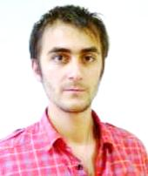
Trainers Team (3)
Doncho Minkov
Technical Trainer @ Telerik Software Academy
Student in Sofia University
Software Engineering
Contestant in the Informatics competitions
Graduate from the first season of Telerik Software Academy
Email: doncho.minkov [at] telerik.com
Blog: http://minkov.it

Slide 10
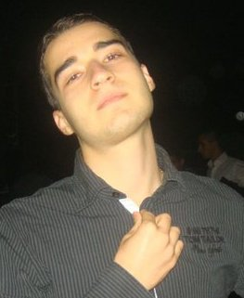
Trainers Team (4)
Nikolay Kostov
Technical Trainer @ Telerik Corp.
Student in Sofia University
Computer Science
Contestant in the IT and Informatics competitions
Graduate from the second season of Telerik Software Academy
Email: nikolay.kostov [at] telerik.com
Blog: http://nikolay.it

Slide 11
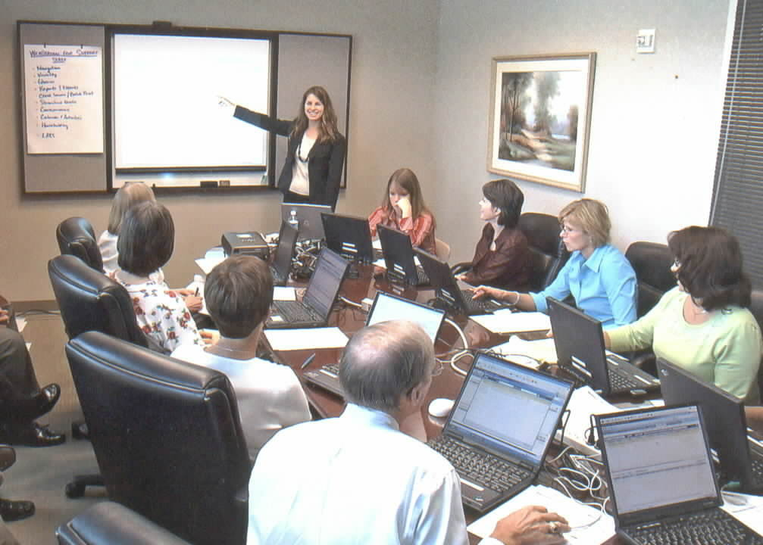
The Training Schedule

Slide 12
School Academy 2012-2013
4-6 October 2013 – Web, HTML5 and CSS3
October 2013 – JavaScript 101
November 2013 – JavaScript UI
December 2013 – Web Front-End
January 2014 – JavaScript OOP
February 2014 – JS Apps, AJAX and REST
March 2014 – JS Frameworks: Angular.js, Knockout.js, Backbone.js, KendoUI, …
April 2014 – Hybrid Mobile Apps
May 2014 – IT Olympiad Preparation
June 2014 – Exams & Certification
<number>

Slide 13


HTML5 and CSS3 Meeting
Day 1 (4th October 2013)
School Academy Introduction
IT Competitions in Bulgaria & IT Olympiad Rules
IT Test
Web Concepts & Tools
HTML Fundamentals
HTML Tables
HTML Forms
<number>

Slide 14

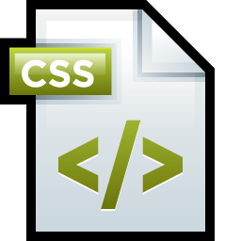
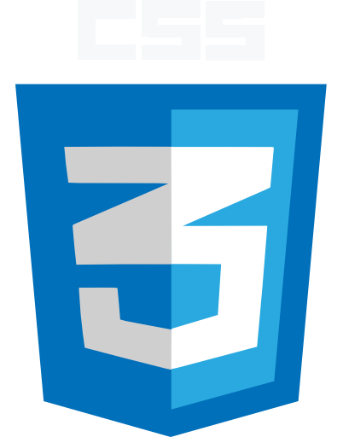
HTML5 and CSS3 Meeting (2)
Day 2 (5th October 2013)
CSS Basics
CSS Presentation
CSS Positioning & Layout
<number>

Slide 15

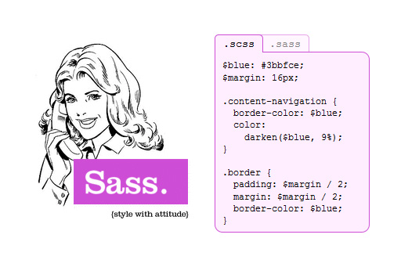
HTML5 and CSS3 Meeting (3)
Day 3 (6th October 2013)
LESS
SASS
<number>

Slide 16

Requirements for the School Students

Slide 17

Requirements for the Trainees
High school students and IT teachers only
University students accepted by exception (if there are free seats)
Basic computer skills
We don’t teach computer literacy
Basic English skills
Ability to read technical documentation is enough
Serious attitude and high motivation!
<number>

Slide 18
Live and Online Participation
Live participation
Attend at least 6 out of 9 meetings
Submit most of the homework assignments
Online participation
Attend less than 6 meetings
Submit almost all homework assignments
All students are involved in the peer evaluation of the assignments
After each homework deadline, you evaluate 3 random homeworks of other student
<number>

Slide 19
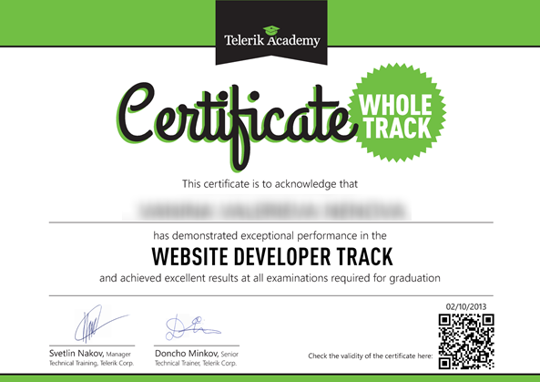
Exams and Certificates
Certification for Best School Academy Attendees

Slide 20
Certification Requirements
Certification requirements
IT Test
Passed live and with good results
Practical Project
Developed and defended live (alone or in a team)
Or high results at the National IT Olympiad
Homework
Live participants → 50% of the homework
Online participants → 90% of the homework
<number>

Slide 21
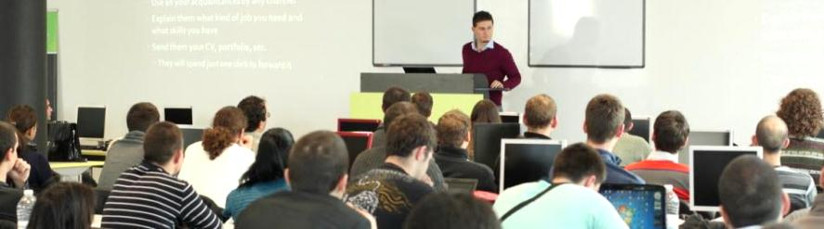

Telerik Academy
Free Trainings for Software Engineers

Slide 22
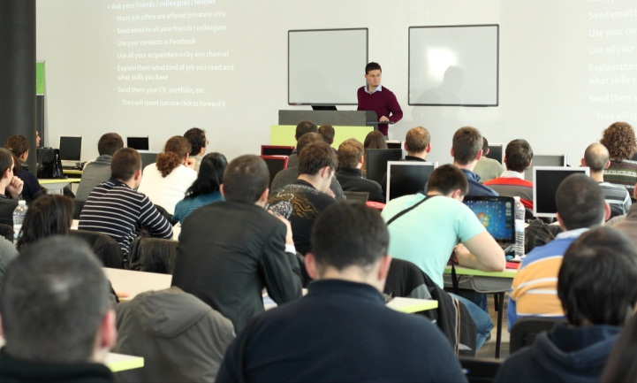
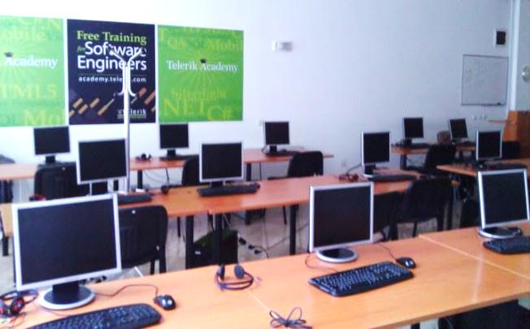
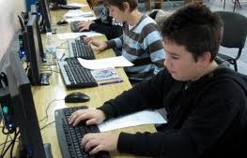
About Telerik Academy
Telerik Academy is an initiative for free training of young software engineers
Software Academy: .NET Devs, Web & XAML Front-Ends, QAs, Dev-Supports
Kids Academy
School Academy
Algo Academy
Online Courses
Contests and free initiatives
<number>

Slide 23
Learning Tracks
Kids Academy
Online Courses
School Academy
Algo Academy
Software Academy
C# Programming
Web Front-End
.NET Dev.
Front-End
QA
Dev. Support
Job at Telerik
Another Job
<number>

Slide 24


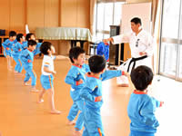
"Software Academy" Program
What is It? How It Works? The Learning Tracks

Slide 25
The “Software Academy” Program @ Telerik
Become a skillful software engineer for free
It takes 12-18 months (~ full time job)
Learning, homework, projects, team work
Web development track (HTML5, JavaScript, …)
Programming track (C#, OOP, DB, …)
Professional tracks
.NET Developer, QA, Support Engineer, Web Front-End, XAML Front-End, ASP.NET Dev, Mobile Dev, Windows 8 Dev, Cloud Dev, …
<number>

Slide 26
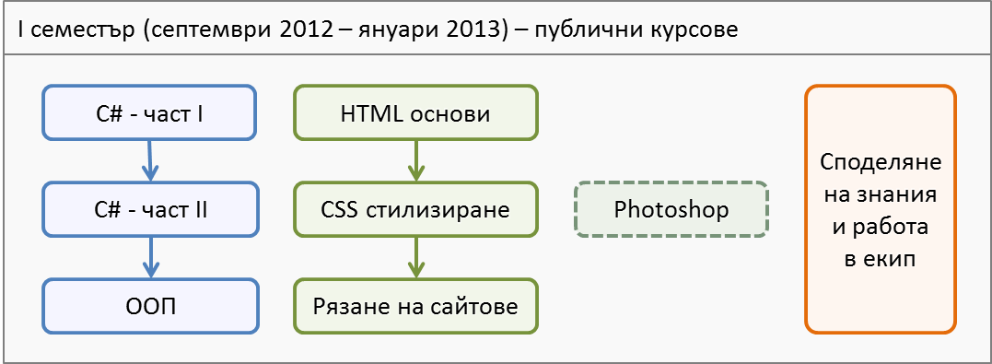
Software Academy: First Semester
The 1st semester
C# programming and Web technologies basics
3-4 times weekly, 4 hours in class + homework
<number>

Slide 27
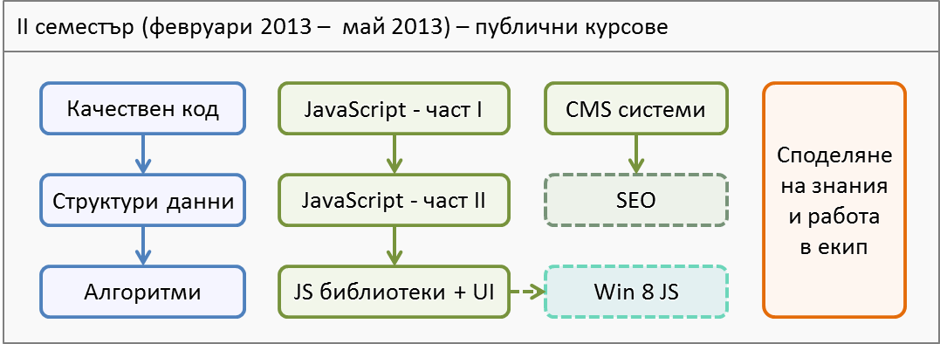
Software Academy: Second Semester
The 2nd semester
Advanced C# and JavaScript programming
3-4 times weekly, 4 hours in class + homework
<number>

Slide 28
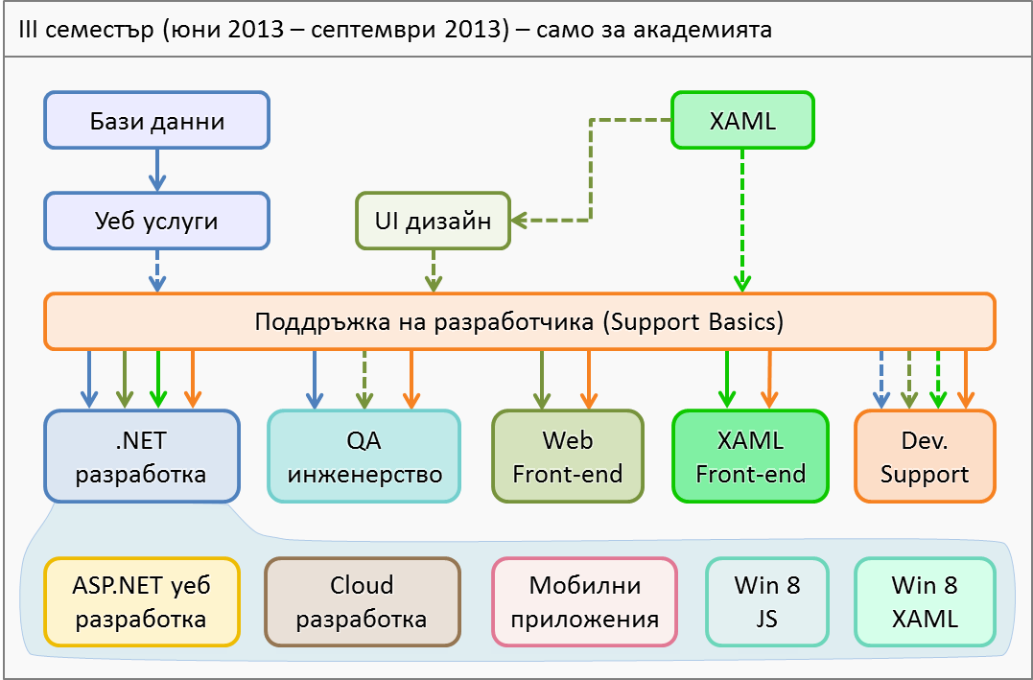
Software Academy: Third Semester
Full time – 5 times weekly, 8 hours in class
<number>

Slide 29
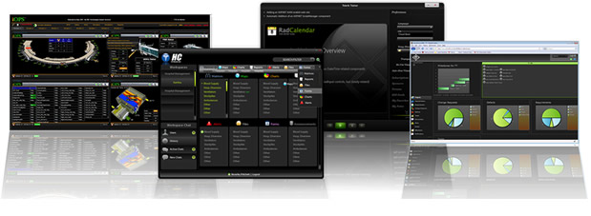


"Software Academy" for High School Students
You Can Start Telerik Software Academy Right Away!

Slide 30
The "Software Academy" Program for High School Students
Semesters 1 and 2 are available online
Pick a course, participate online
Follow the video lectures & get materials online
Do the homework and submit it
Online exams to qualify for live exams
Attend the live exams at Telerik Academy
We will track and keep your results
You can pass first two semesters while in school
The rest when you become university student
<number>

Slide 31
Telerik School Academy
http://academy.telerik.com

